Slide 1

Streaming Data Analytics
Unit 3 – By Dr. Yousefi

Slide 2
Discussion
Description:
Primary Response is due by Thursday (11:59:59pm Central), and Peer Responses are due by Tuesday (11:59:59pm Central).
Primary Response: Within the Discussion Board area, write 300-500 words that respond to the following questions with your thoughts, ideas, and comments. This will be the foundation for future discussions with your classmates. Be substantive and clear and use examples to reinforce your ideas.

Slide 3
Discussion
For this Discussion Board, please complete the following:
Machine learning has been around for several decades, but it has recently exploded due to much more data being available, more powerful computing, and more tools that are easier to use. Machine learning is different from traditional programming in that it allows a data scientist to create a learning algorithm that identifies patterns and uses these for future predictions.
For this task, you will research the application of machine learning to streaming data.

Slide 4
Discussion
An example in your daily life is an online gaming company that collects streaming data about player-game interactions and feeds the data into its gaming platform. It then analyzes the data in real-time and offers incentives and dynamic experiences to engage its players.
Describe the differences between streaming data and at-rest data.
What are other streaming data examples and potential algorithms for use in your daily life?
Would you recommend stream or batch processing for processing the big data collected from online gaming? Explain your decision.

Slide 5
Discussion
Responses to Other Students: Respond to at least 2 of your fellow classmates with at least a 100-200 word reply about his or her Primary Task Response regarding items you found to be compelling and enlightening. To help you with your discussion, please consider the following questions:
What did you learn from your classmate's posting? What additional questions do you have after reading the posting?
What clarification do you need regarding the posting?
What differences or similarities do you see between your posting and other classmates' postings?

Slide 6
Model Answer:
What makes streaming different is that recent history is used to make predictions, and the model will likely be updatable and evolve as data streams through the data pipeline and infrastructure.
Streaming data will likely use incremental algorithms and use recent history versus all history.
At-rest data will have a wider array of algorithms and will use a different training or testing approach to build the model and likely not update as often.
Both can use regression and classification supervised learning algorithms, but the difference is incremental for streaming and not for at-rest.
Provide examples of algorithms and streaming data in your daily life.

Slide 7
Model Answer:
Combining machine learning with streaming data can create an environment where predictions can be made in real-time based on tangible data.
For instance, if a manufacturer were to embed an algorithm in an automobile computer control system, it could collect data that will help predict parts failures before they occur.

Slide 8
Links
Data Science Versus Big Data Versus Data Analytics
This article talks about the differences between data science, big data, and data analytics.
The 4 Types of Data Analytics
This Web site explores 4 different types of data analytics and provides insight into how to apply them effectively.
Machine Learning
This video explores the fundamentals of machine learning.
Spark and Machine Learning
This video examines machine learning and how it can use streams of data.
Scikit-Learn Tutorial
This tutorial provides an overview of Scikit-Learn (a popular Python machine learning library).
From Machine Learning to Machine Reasoning: An Essay
This article describes the manipulation applicable to training systems to build reasoning capabilities.
Mastering Machine Learning Algorithms: Expert Techniques to Implement Popular Machine Learning Algorithms and Fine-Tune Your Models
This article discusses various techniques used to implement machine learning algorithms.

Slide 9
IP3
For this assignment, you will consume the data from https://www.pubnub.com/developers/realtime-data-streams/twitter-stream/ and locally on your PC in Python.
Construct a machine learning algorithm on these data. The algorithm may be supervised or unsupervised.

Slide 10
The project deliverables include the following:
Create an ingest job in Python that consumes the identified data.
Construct an unsupervised or supervised machine learning algorithm to predict the numerical or categorical outcome based on the defined goal.
Discuss the results.
Provide a discussion on the solution design, interworking's, and how the algorithm is to be interpreted.
Once complete, submit your assignment for grading in a Microsoft Word document.

Slide 11
Live Chat Extra Credit Summary
In this class, you have the opportunity to receive credit for attending Live Chats or reviewing the chat archive. This opportunity is available once per week. To receive these points, you can either:
1. Attend the Live Chat session. or
2. Review the archived chat session and submit a 200-word summary of the content. The archive review summary must meet the expectations described below.
Summarize the content of the chat. Some ideas for what to include are a description of what information was covered and how you will apply this information to your academic or professional work.
Label the document "Chat Credit" with the date the Live Chat was presented.
A summary must be submitted within 1 week of the Live Chat to be considered for credit.

Slide 12
Objective
Understand the differences between streaming data analytics and at-rest data analytics, as well as the foundation, techniques, and processes of the streaming data analytics

Slide 13
What is Analytics?
Analytics is the scientific process of discovering and communicating the meaningful patterns which can be found in data.
It is concerned with turning raw data into insight for making better decisions.

Slide 14
What is Analytics?
Analytics relies on the application of statistics, computer programming, and operations research to quantify and gain insight into data meanings.
It is especially useful in areas which record a lot of data or information.

Slide 15
What is Analytics?
Analytics leads us to find the hidden patterns in the world around us, from consumer behaviors, athlete and team performance, to finding connections between activities and diseases.
This can change how we look at the world, and usually for the better. Sometimes we think that a process is already working at its best, but sometimes data tells us otherwise, so analytics helps us to improve our world.

Slide 16
Related Terms
Predictive Analytics
Business Analytics
Customer Analytics
Data Analytics
Big Data
Big Data Analytics
Behavioral Analytics
Advanced Analytics

Slide 17
Data Science vs. Big Data vs. Data Analytics
Data is everywhere and part of our daily lives in more ways than most of us realize in our daily lives.
The amount of digital data that exists—that we create—is growing exponentially.
According to estimates, in 2021, there are 74 zettabytes of generated data. That’s expected to double by 2024.

Slide 18
What Is Data Science?
Hence, there is a need for professionals who understand the basics of data science, big data, and data analytics.

Slide 19
What Is Data Science?
Dealing with unstructured and structured data, data science is a field that comprises everything that is related to data cleansing, preparation, and analysis.
Data science is the combination of statistics, mathematics, programming, problem-solving, capturing data in ingenious ways, the ability to look at things differently, and the activity of cleansing, preparing, and aligning data.
This umbrella term includes various techniques that are used when extracting insights and information from data.

Slide 20
What is Data Analytics?
Data analytics is the science of examining raw data to reach certain conclusions.
Data analytics involves applying an algorithmic or mechanical process to derive insights and running through several data sets to look for meaningful correlations.

Slide 21
What is Data Analytics?
It is used in several industries, which enables organizations and data analytics companies to make more informed decisions, as well as verify and disprove existing theories or models.
The focus of data analytics lies in inference, which is the process of deriving conclusions that are solely based on what the researcher already knows.

Slide 22
Skills Required to Become a Data Scientist
Education: 88 percent have master’s degrees, and 46 percent have PhDs
In-depth knowledge of SAS or R. For data science, R is generally preferred.
Python coding: Python is the most common coding language that is used in data science, along with Java, Perl, and C/C++.
Hadoop platform: Although not always a requirement, knowing the Hadoop platform is still preferred for the field. Having some experience in Hive or Pig is also beneficial.

Slide 23
Skills Required to Become a Data Scientist
SQL database/coding: Although NoSQL and Hadoop have become a significant part of data science, it is still preferred if you can write and execute complex queries in SQL.
Working with unstructured data: It is essential that a data scientist can work with unstructured data, whether on social media, video feeds, or audio.

Slide 24
Skills Required to Become a Data Analyst
Programming skills: Knowing programming languages, such as R and Python, are imperative for any data analyst.
Statistical skills and mathematics: Descriptive and inferential statistics, as well as experimental designs, are required skills for data scientists.
Machine learning skills
Data wrangling skills: The ability to map raw data and convert it into another format that enables more convenient consumption of the data
Communication and data visualization skills
Data intuition: it is crucial for a professional to be able to think like a data analyst.

Slide 25
Models and data – Machine learning
Machine learning algorithms work with data. They create associations, find out relationships, discover patterns, generate new samples, and more, working with well-defined datasets.
Unfortunately, sometimes the assumptions or the conditions imposed on them are unclear, and a lengthy training process can result in a complete validation
:

Slide 26
Models and data – Machine learning
failure. Even if this condition is more vital in deep-learning contexts, we can think of a model as a gray box (the simplicity of many standards algorithms guarantees some transparency), where a vectorial input X^ is transformed into a vectorial output Y^

Slide 27
Learning Machine Learning
Machine learning can be summarized as learning a function (f) that maps input variables (X) to output variables (Y).
Y = f(x)
An algorithm learns this target mapping function from training data.
The form of the function is unknown, so our job as machine learning practitioners is to evaluate different machine learning algorithms and see which is better at approximating the underlying function.

Slide 28

Training and validation sets
In real problems, the number of samples is limited, and it's usually necessary to split the
initial set X (together with Y) into two subsets as follows:
Training set used to train the model
Validation set used to assess the score of the model without any bias, with
samples never seen before

Slide 29

Training and validation sets
According to the nature of the problem, it's possible to choose a split percentage ratio of
70% – 30% (a good practice in machine learning, where the datasets are relatively small), or
a higher training percentage (80%, 90%, up to 99%) for deep learning tasks where the number of samples is very high. In both cases, we assume that the training set contains all the information required for a consistent generalization.

Slide 30

Training and validation sets
In Scikit-Learn, it's possible to split the original dataset using the train_test_split()
function, which allows specifying the train/test size, and if we expect to have randomly
shuffled sets (default). For example, if we want to split X and Y, with 70% training and 30%
test, we can use:
from sklearn.model_selection import train_test_split
X_train, X_test, Y_train, Y_test = train_test_split(X, Y, train_size=0.7,
random_state=1)

Slide 31

Cross-validation
The cross-validation technique provides a valid method to detect the problem of wrongly selected test sets.
In particular, we're going to use the K-Fold cross-validation approach. The idea is to split dataset X into a moving test set and a training set (the remaining part). The size of the test set is determined by the number of folds so that, during k iterations, the test set covers the whole original dataset.

Slide 32
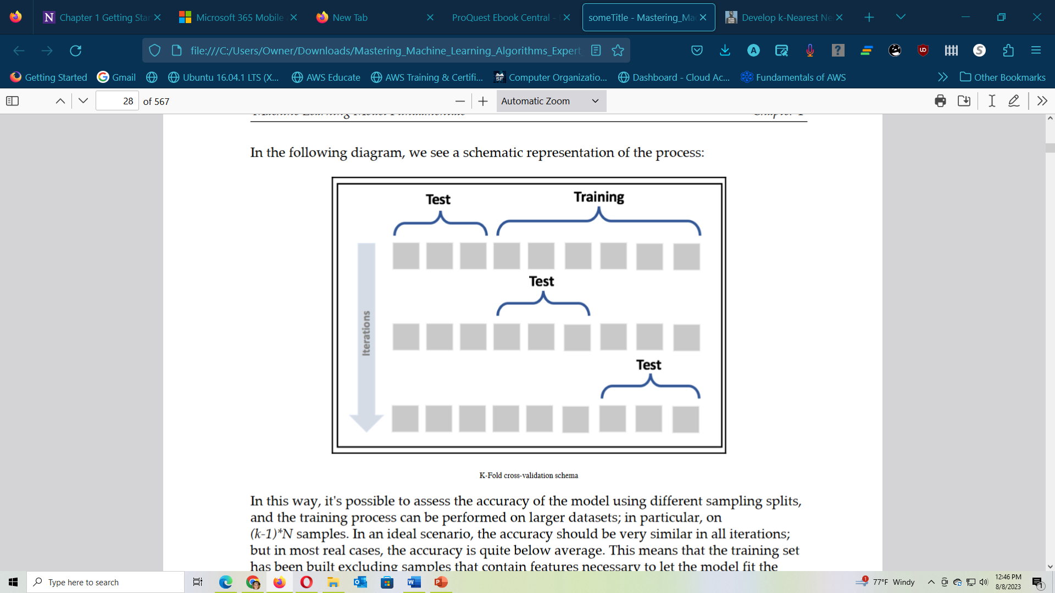

Slide 33

Models
Parametric:
Any model that captures all the information about its predictions within a finite set of parameters.
non- parametric:
Because they are based only on the structure of the data

Slide 34
Machine learning (ML)
is the study of computer algorithms that can improve automatically through experience and using data.
It is seen as a part of artificial intelligence. Machine learning algorithms build a model based on sample data, known as "training data", to make predictions or decisions without being explicitly programmed.
Machine learning algorithms are used in a wide variety of applications, such as in medicine, email filtering, speech recognition, and computer vision, where it is difficult or unfeasible to develop conventional algorithms to perform the needed tasks.

Slide 35
How to interpret a Machine Learning model
When we talk about machine learning algorithms, there is the idea that the model has a very good performance in terms of its prediction capacity, but that being a complex mathematical construction, its interpretation is lost.
Therefore, unable to be understood, it becomes a black box with a halo of mystery around it.

Slide 36
How to interpret a Machine Learning model
A black box that only yields a number, and that according to a documentation has a predictive power of a certain level, does not contribute so that those who hold positions of importance within organizations can understand the operation and advantages of algorithms, nor does it contribute to make better decisions with them.

Slide 37
How to interpret a Machine Learning model
As a result of this situation, the big question arises for those of us who work in data science:
how to sell a product that most people do not understand how it works?
Therefore, algorithm interpretation methodologies become even more relevant; they allow anyone to understand how the model works internally. Since the output of this process is so intuitive, it is possible to make high-value decisions easily.

Slide 38
Interpreting the Results of a Machine Learning Algorithm
The initial suggestion for the content of this series will be as follows:
Part 0— What is the scope of data science Part 1 — Introduction to Interpreting ML
Part 2 — Interpreting models of high bias and low variance. Part 3 — Interpreting models of low bias and high variance. Part 4 — Is it possible to solve the trade-off between bias and variance? Part 5 — Local Methods of Interpretability. Part 6 — Global Methods of Interpretability.

Slide 39
Construct a machine learning algorithm
Dataset
A dataset is the starting point in your journey of building the machine learning model. Simply put, the dataset is essentially an M×N matrix where M represents the columns (features) and N the rows (samples).
Columns can be broken down to X and Y.
Firstly, X is synonymous with several similar terms such as features, independent variables and input variables.
Secondly, Y is also synonymous with several terms namely class label, dependent variable and output variable.

Slide 40
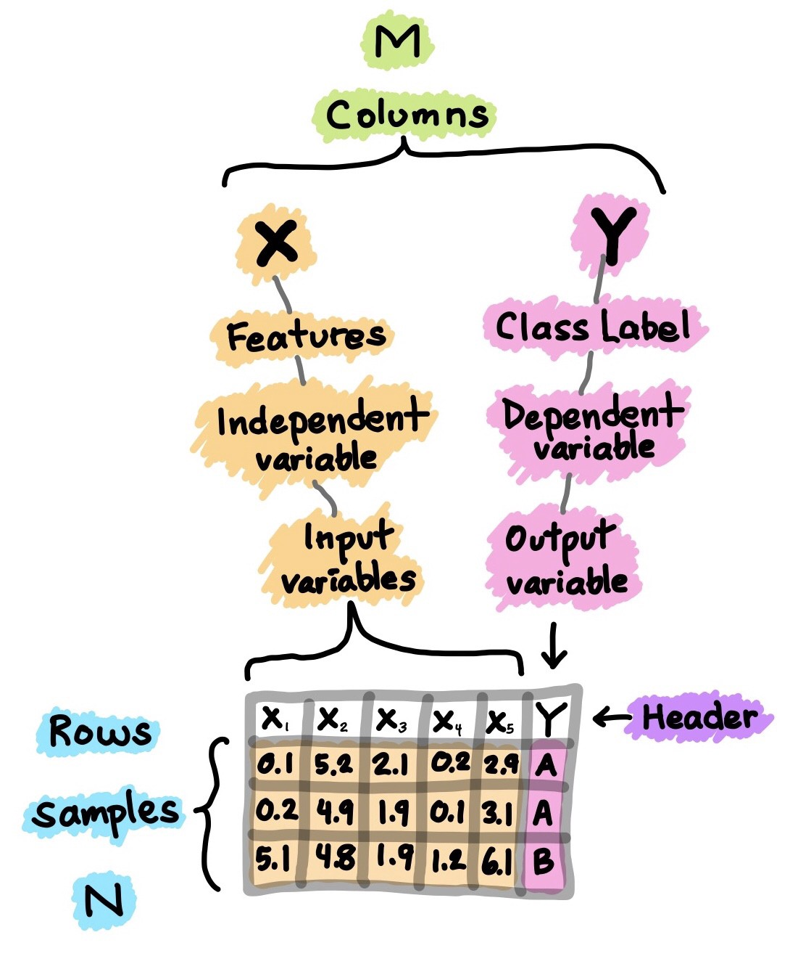

Slide 41
Construct a machine learning algorithm
It should be noted that a dataset that can be used for supervised learning (can perform either regression or classification) would contain both X and Y whereas a dataset that can be used for unsupervised learning will only have X.
Moreover, if Y contains quantitative values, then the dataset (comprising of X and Y) can be used for regression tasks whereas if Y contains qualitative values, then the dataset (comprising of X and Y) can be used for classification tasks.

Slide 42
Exploratory Data Analysis
Exploratory data analysis (EDA) is performed in order to gain a preliminary understanding and allow us to get acquainted with the dataset.
In a typical data science project, one of the first things that I would do is “eyeballing the data” by performing EDA so as to gain a better understanding of the data.

Slide 43
Three major EDA approaches that I normally use includes:
Descriptive statistics — Mean, median, mode, standard deviation
Data visualizations — Heat maps (discerning feature intra-correlation), box plots (visualize group differences), scatter plots (visualize correlations between features), principal component analysis (visualize the distribution of clusters presented in the dataset), etc.
Data shaping — Pivoting data, grouping data, filtering data, etc.

Slide 44
How to do the IP
Create an ingest job in Python that consumes the identified data
https://www.udacity.com/blog/2022/12/how-to-ingest-data-with-python.html

Slide 45
How to do the IP
Construct an unsupervised or supervised machine learning algorithm to predict the numerical or categorical outcome based on the defined goal.
https://www.v7labs.com/blog/supervised-vs-unsupervised-learning
https://machinelearningmastery.com/supervised-and-unsupervised-machine-learning-algorithms/
https://www.techtarget.com/searchenterpriseai/post/2-supervised-learning-techniques-that-aid-value-predictions

